Slide 1
PIRE 2014 Information Session

Slide 2
Dr. Judith Kroll

Slide 3
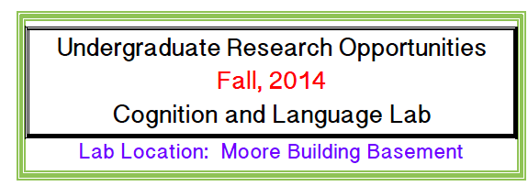
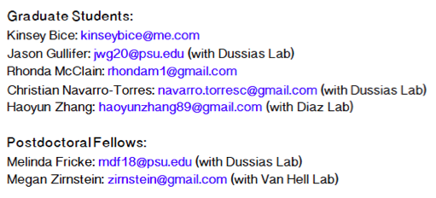
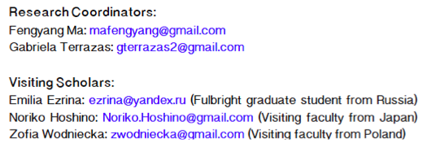
Judith Kroll: jfk7@psu.edu
Center for Language Science Laboratories

Slide 4
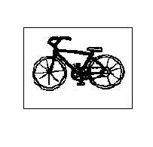
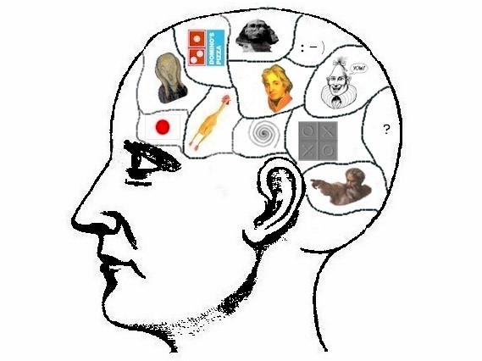

The bilingual is a mental juggler: Both languages appear to be active regardless of the requirement to use one language alone:
Dutch-English speaker
“bike”
“fiets”
It is not possible to simply switch off one language!

Slide 5

What is the consequence of parallel activity and competition
across the bilingual’s two languages?
Juggling may tune brain networks that
enable control and build cognitive reserve.

Slide 6

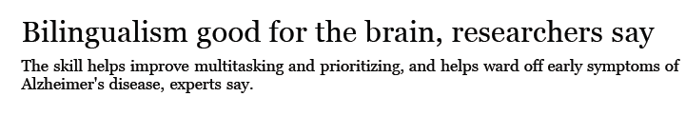

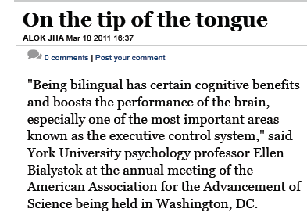

Slide 7
The focus of our research is on language processing in bilinguals
and second language learners:
How do bilinguals control the language not in use?
What are the consequences of learning to control the two
languages for cognition and the brain?
What enables some adults to learn a second language easily
while others struggle?

Slide 8

One hypothesis about second language learning: Some adults can
simply not control their native language!
Contact me if you are interested: jfk7@psu.edu

Slide 9
Dr. Daniel Weiss

Slide 10
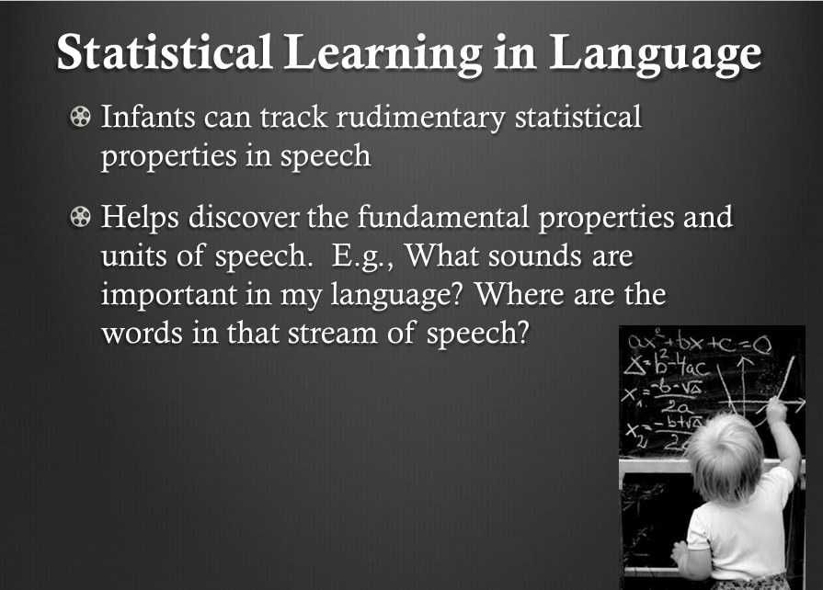

Slide 11
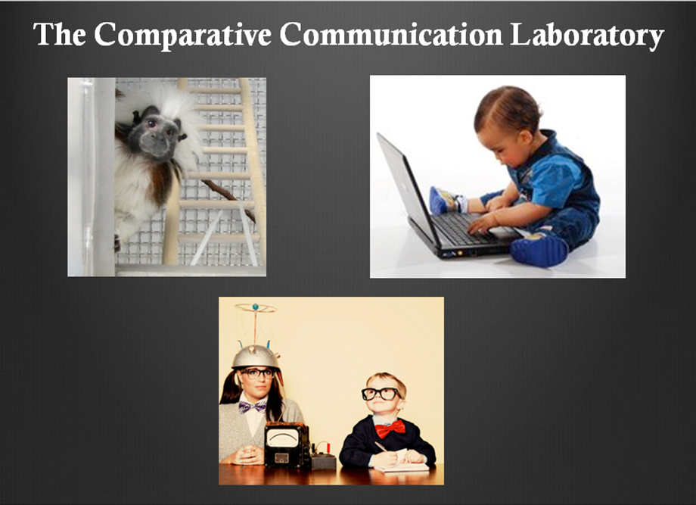

Slide 12
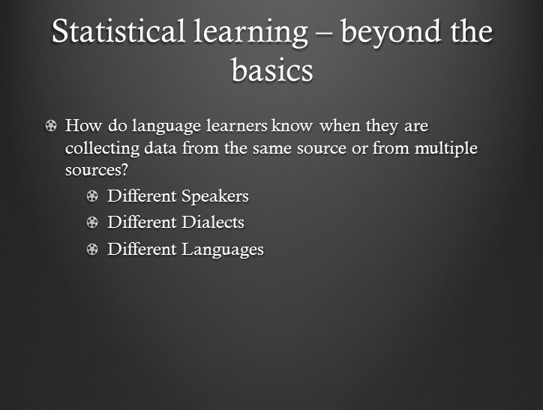

Slide 13
Dr. Karen Miller

Slide 14
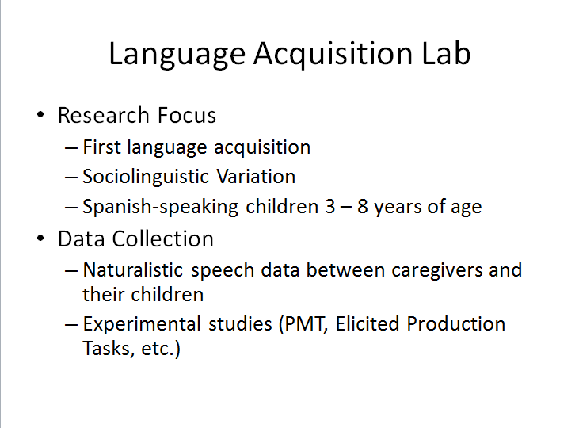

Slide 15
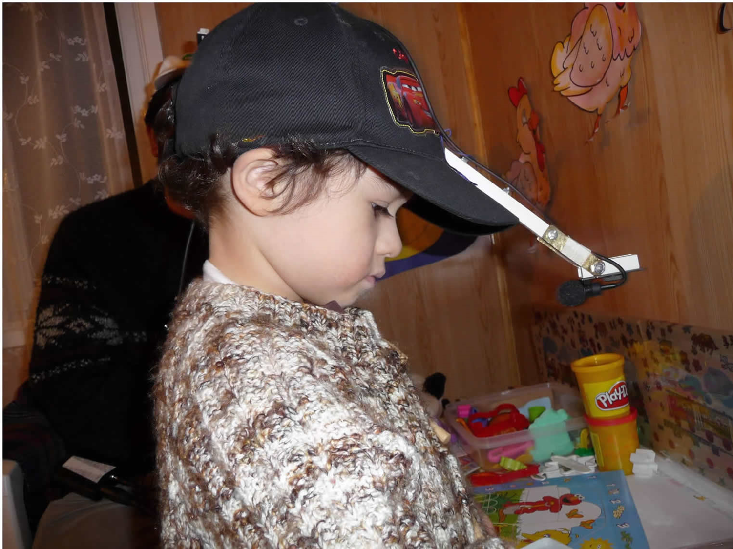

Slide 16
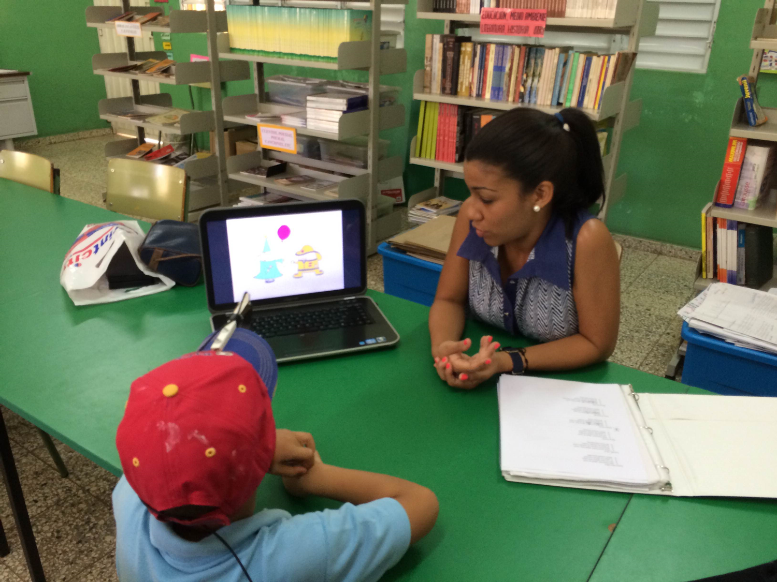

Slide 17
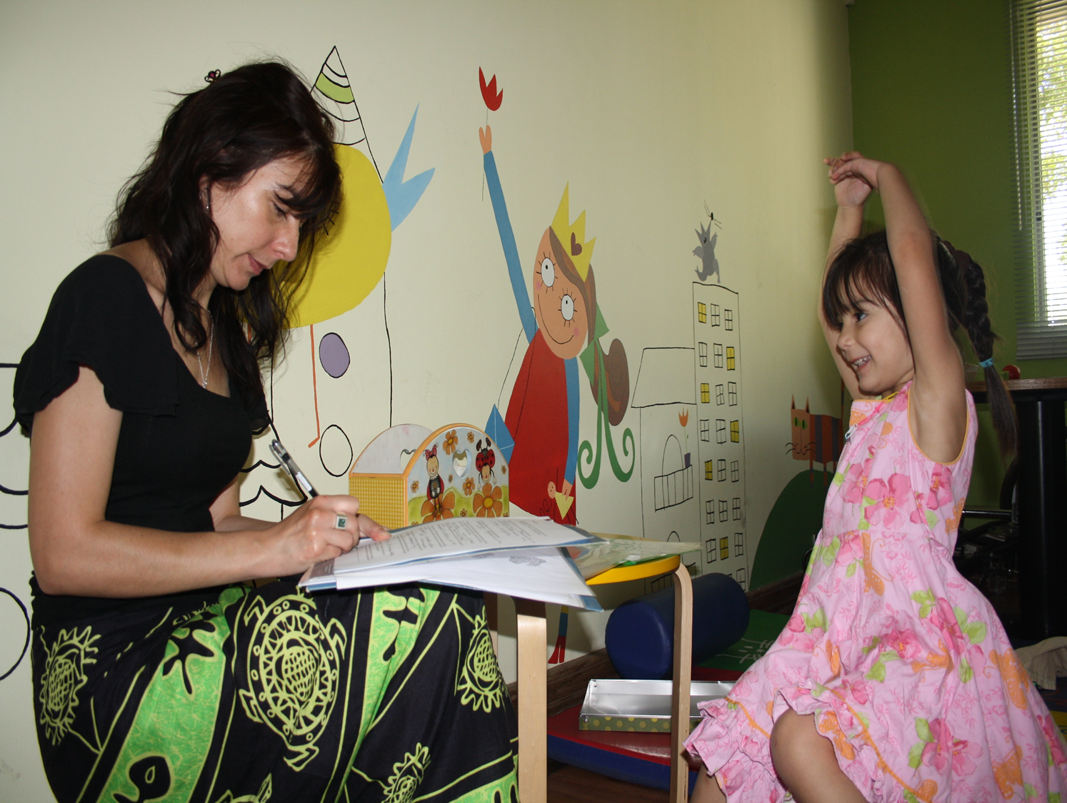

Slide 18
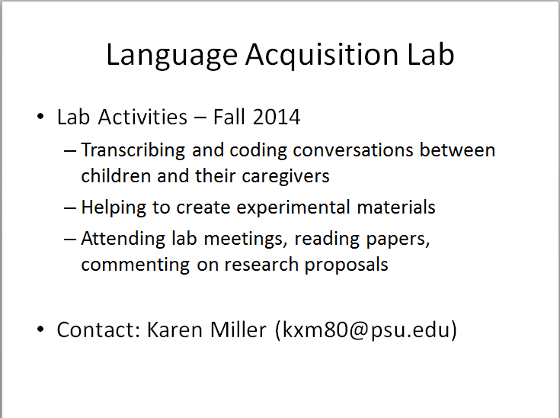

Slide 19
Dr. Carol Miller

Slide 20
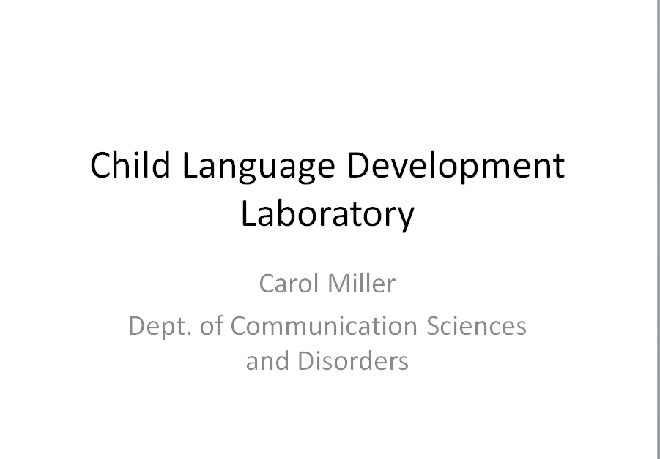

Slide 21
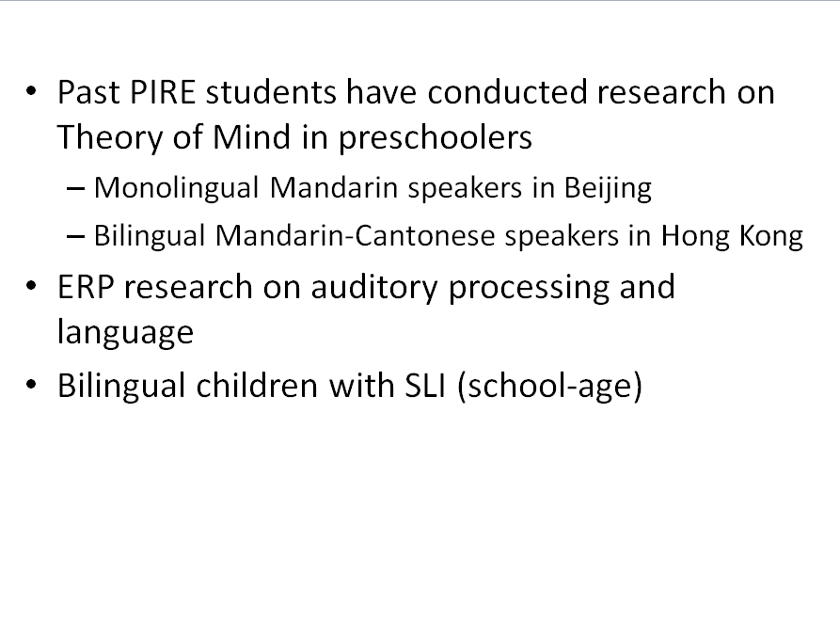

Slide 22
Dr. Marianna Nadeu nadeu@psu.edu

Slide 23
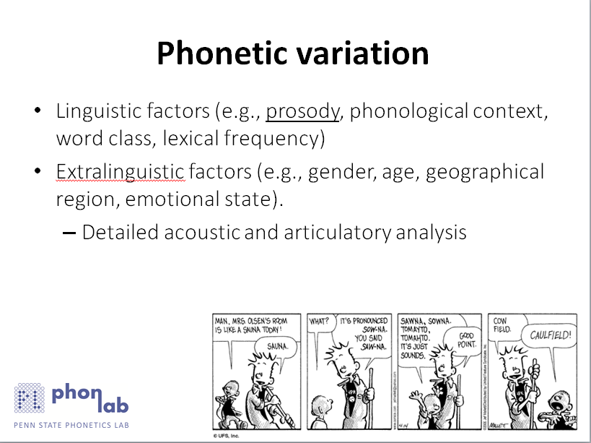

Slide 24
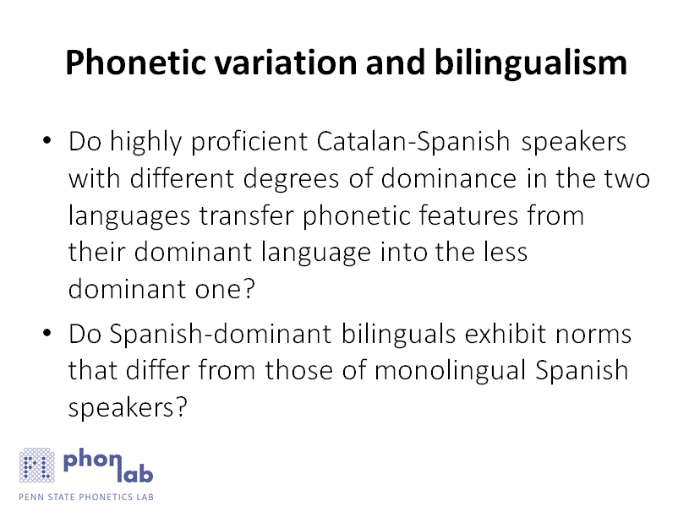

Slide 25
Dr. Matthew Carlson

Slide 26
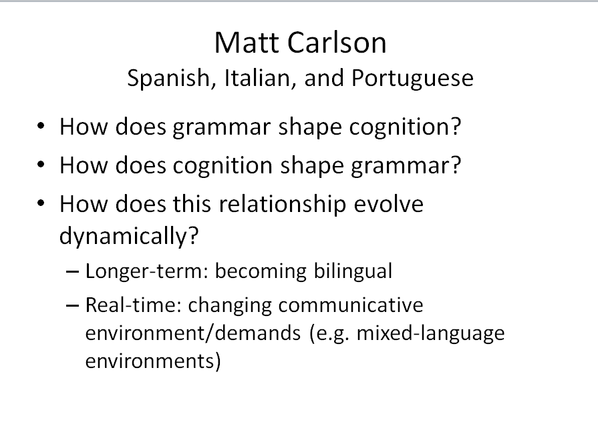

Slide 27
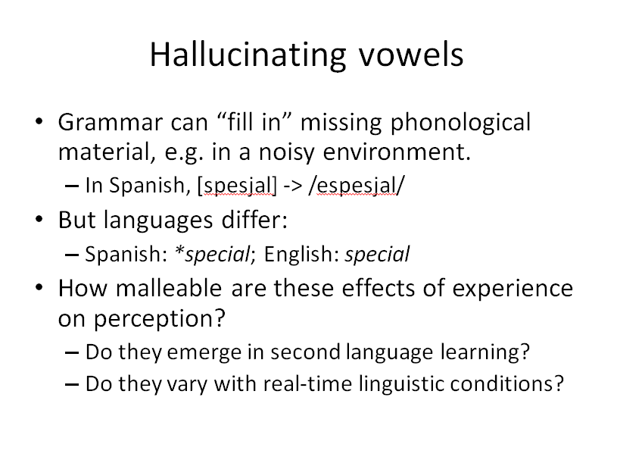

Slide 28
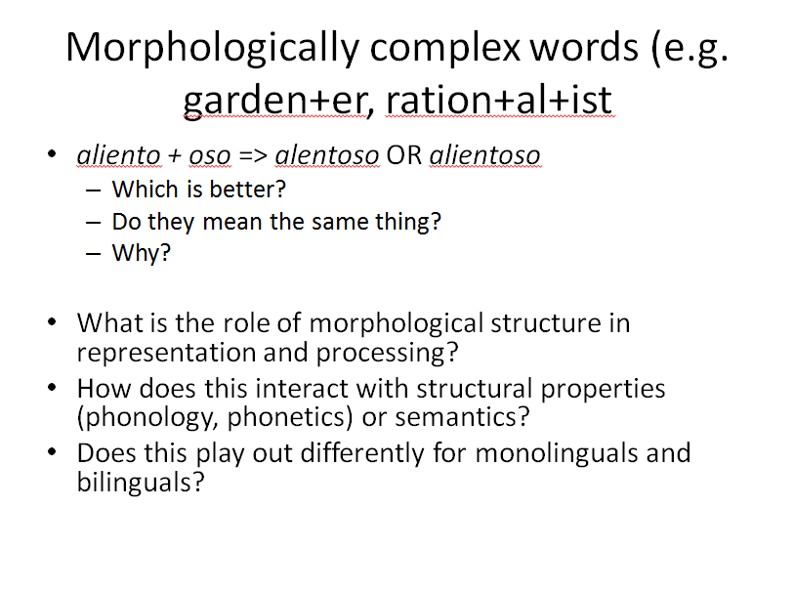

Slide 29
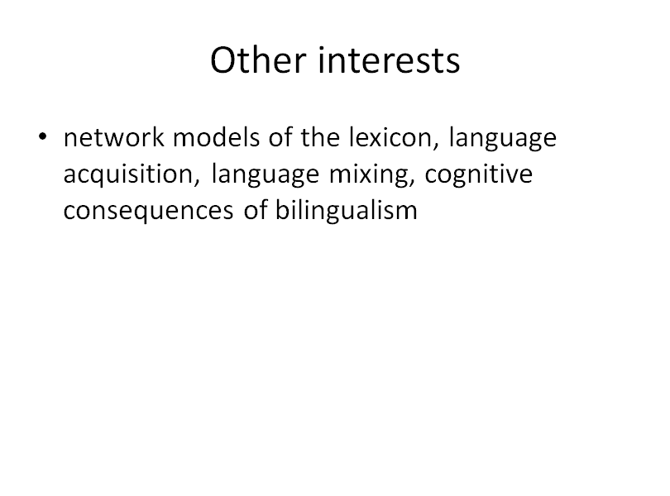

Slide 30
Dr. John Lipski

Slide 31
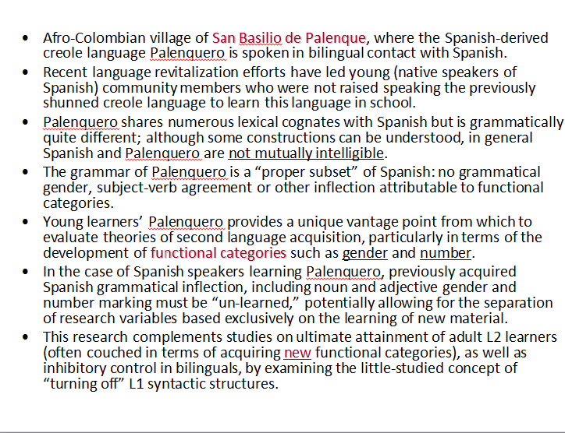

Slide 32


Slide 33
Dr. Mike Putman Hyoun-A and Lara

Slide 34
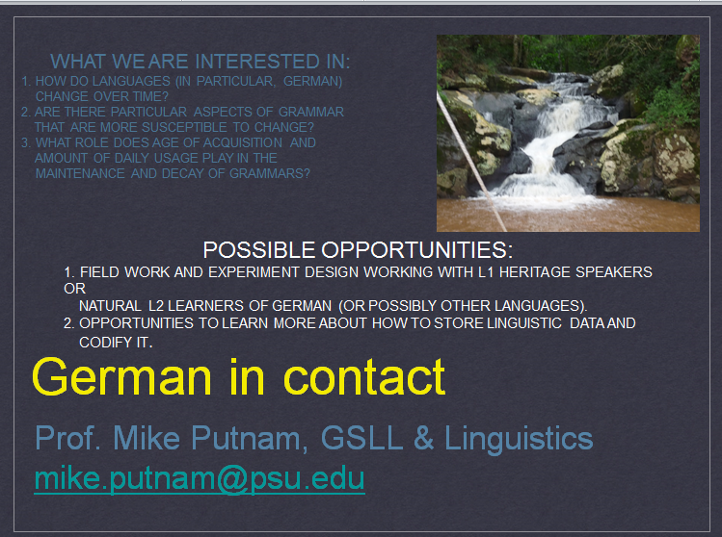

Slide 35
Dr. Lisa Reed

Slide 36
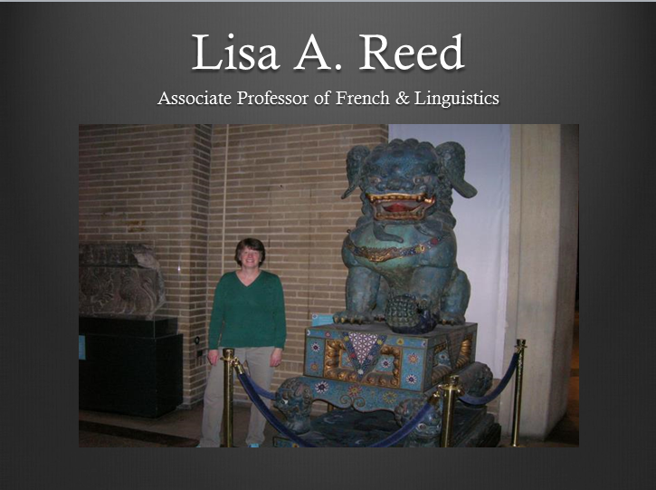

Slide 37
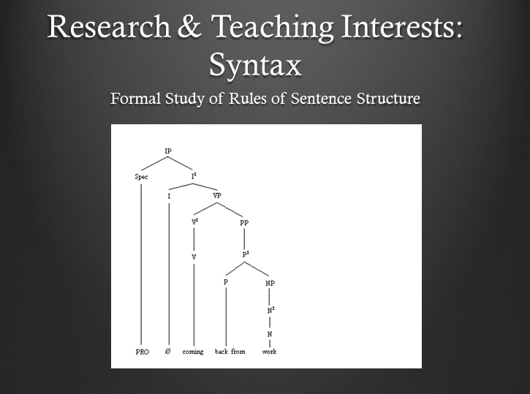

Slide 38
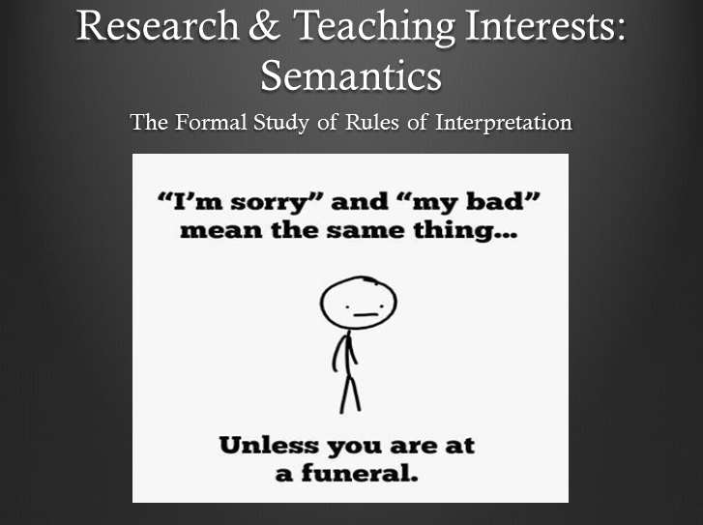

Slide 39
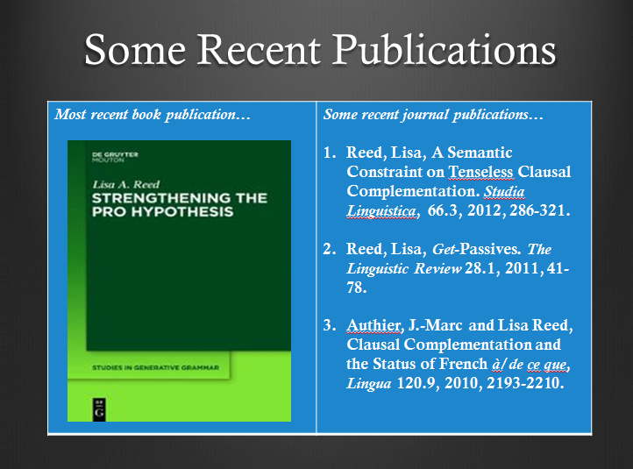

Slide 40
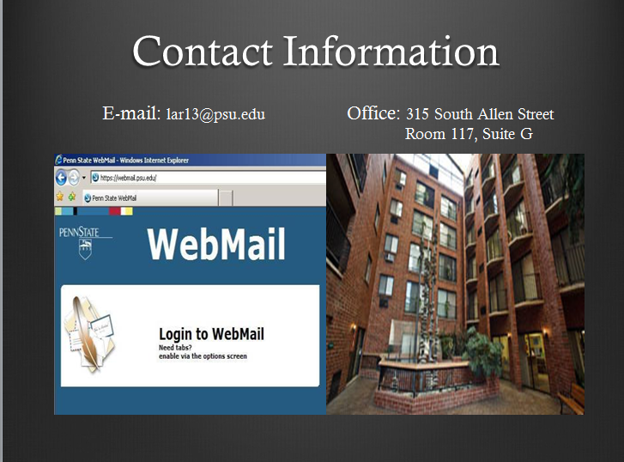

Slide 41
Dr. Giuli Dussias

Slide 42
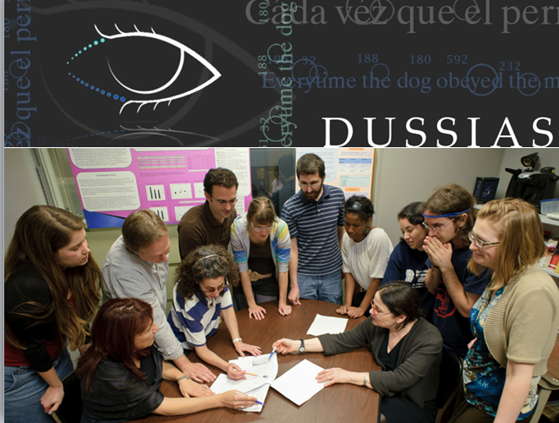

Slide 43
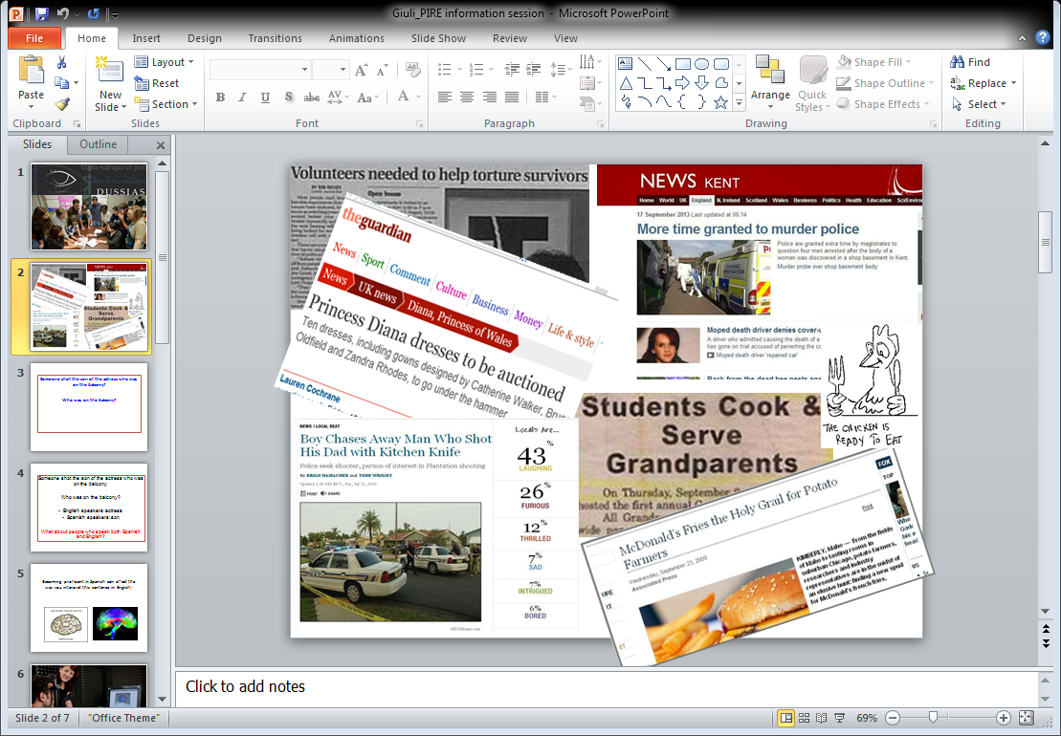
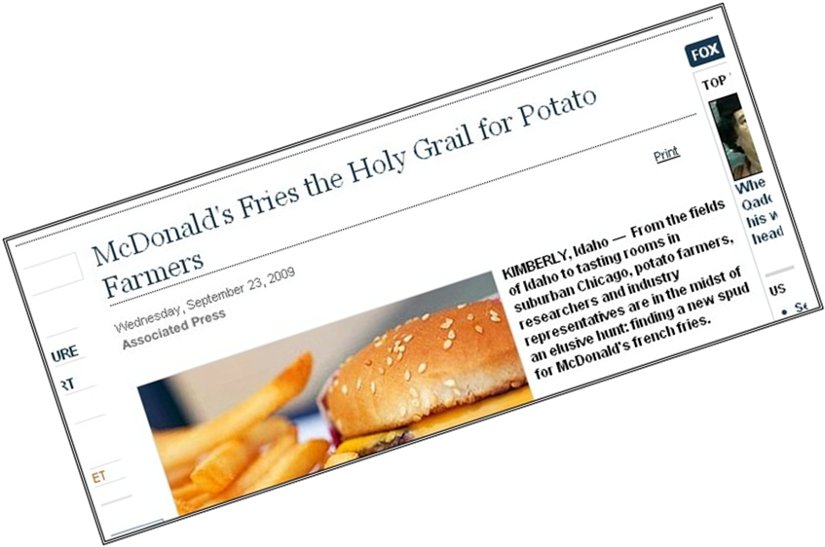

Slide 44
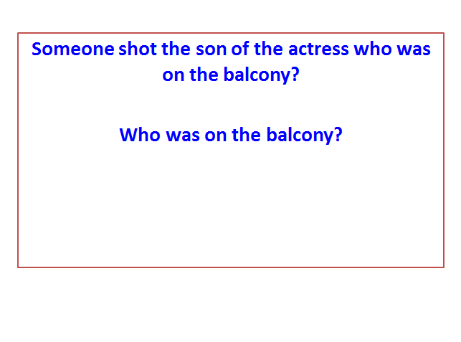

Slide 45
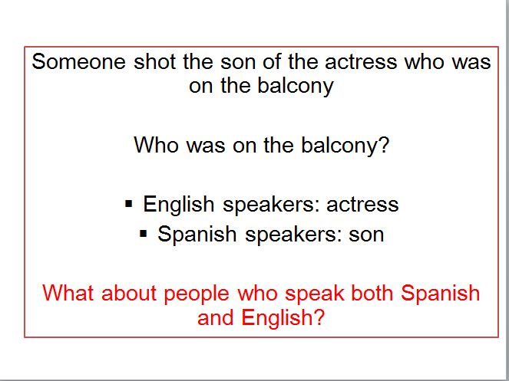

Slide 46
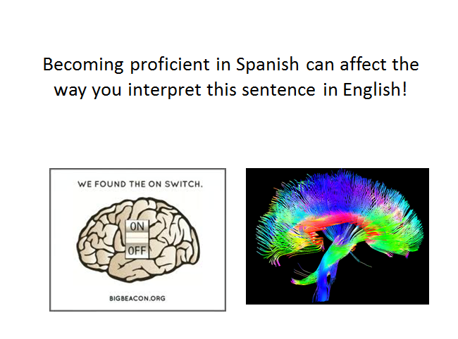

Slide 47
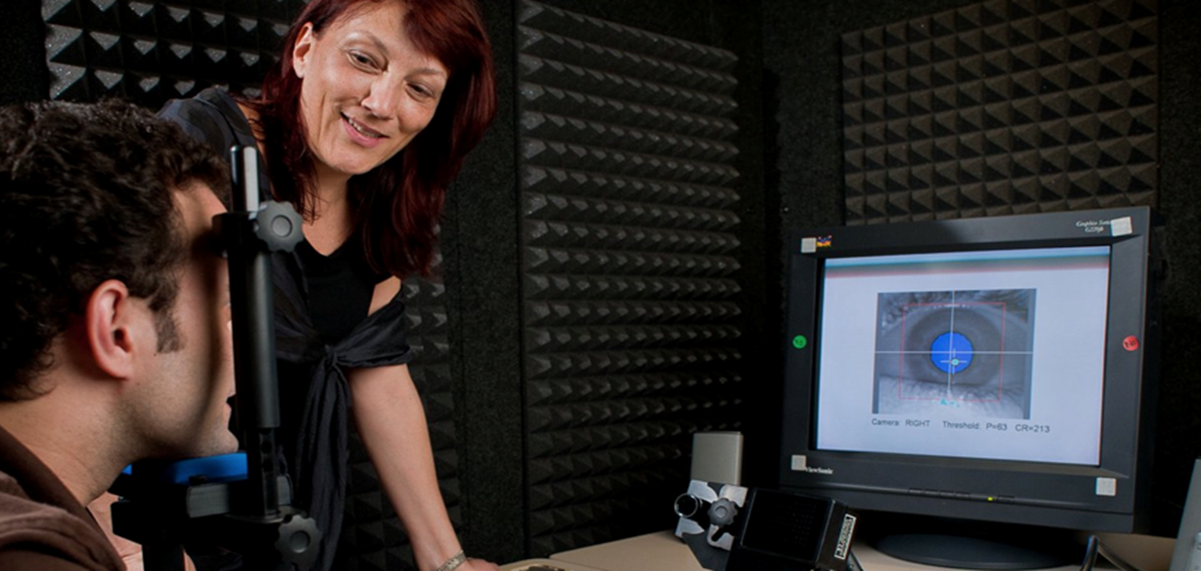
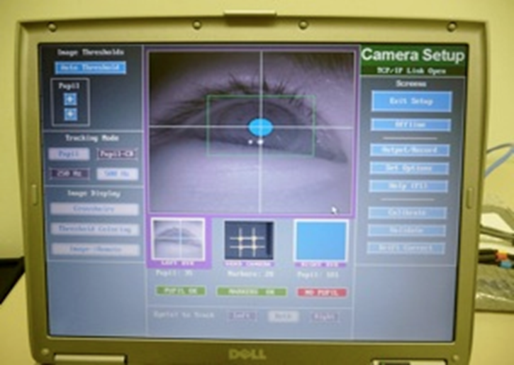
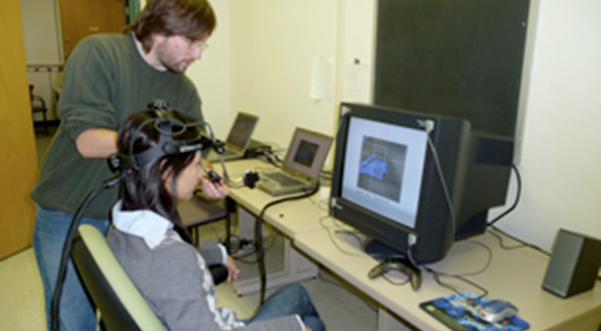

Slide 48
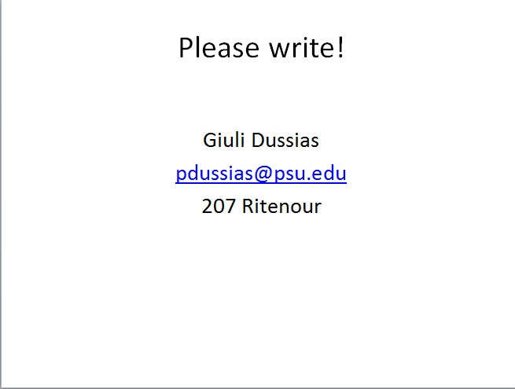

Slide 49
Dr. Eleonora Rossi

Slide 50
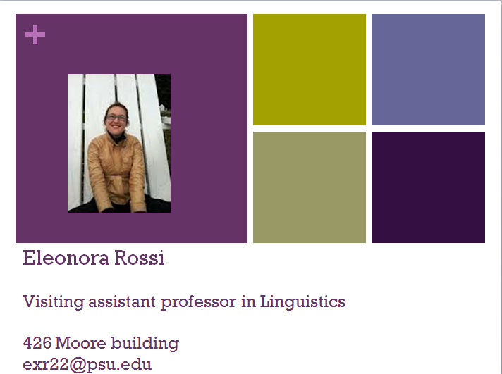

Slide 51
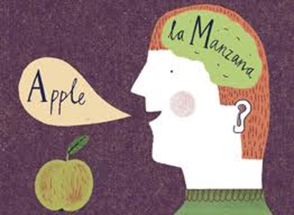
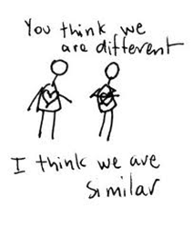
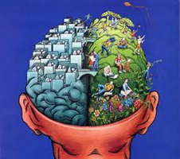
The questions I am interested in
How do bilingual speakers juggle between their two languages?
Is a second language learned later un life always processed differently than a native language? Or can we observe similarities between the two processes?
What are the cognitive and brain mechanisms that are at the base of bilingual language processing?
What role does memory play while learning a second language, and how does learning a second language impact the native one?

Slide 52
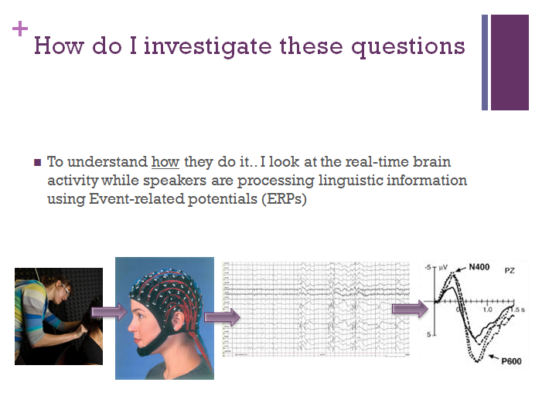

Slide 53
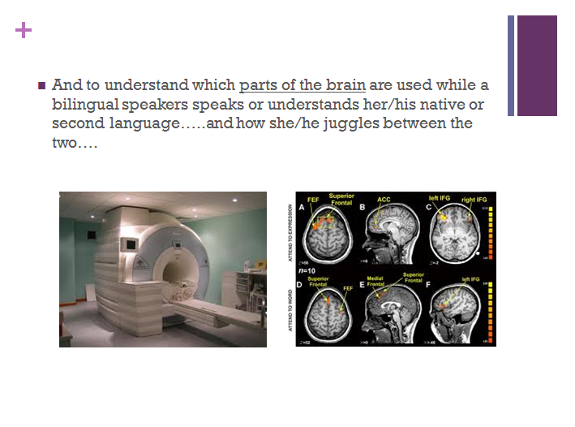

Slide 54
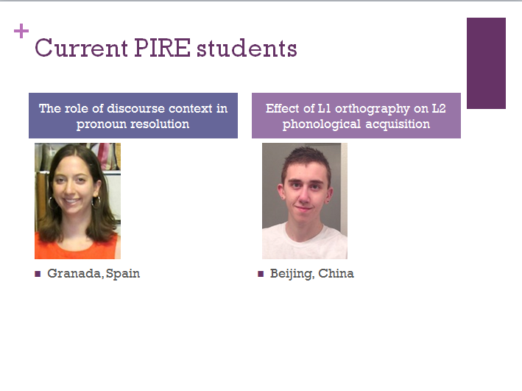

Slide 55
Dr. Carrie Jackson

Slide 56
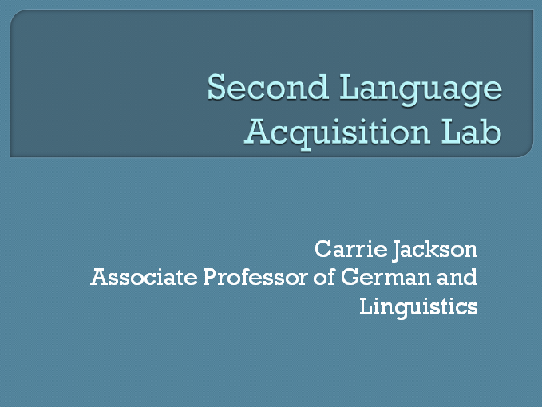

Slide 57

Questions we ask. . .
How do adult second language learners process grammatical and semantic information in the L2 in real time?
What factors can have an impact on the ultimate success of adult L2 learning (e.g., study abroad; type of input and instruction; individual differences)?
How can experimental studies (and the results from such studies) inform and improve foreign language instruction?

Slide 58

Some recent and ongoing studies
How L1 and L2 speakers use different types of semantic and grammatical information to compute subject-verb agreement in the L1 and L2 (Beth Mormer, PIRE undergrad 2012; Kaylee Roupas, PIRE undergrad 2013; ongoing collaborations)
How priming activities can improve fluency and increase the use of more native-like word order in L2 speech (ongoing project with PSU undergrads and other collaborators)
Whether cognates facilitate the production of more difficult syntactic structures in L2 speech (Abby Massaro, PIRE undergrad 2014)
What can we do to facilitate the acquisition and processing of grammatical gender in L2 learners (Courtney Fowler Johnson, PhD student and PIRE graduate fellow 2012; Patricia Schempp, PhD student; Leah Pappas, PIRE undergrad 2013; Julia Hotchner, PIRE undergrad 2014)

Slide 59
Dr. Janet van Hell

Slide 60
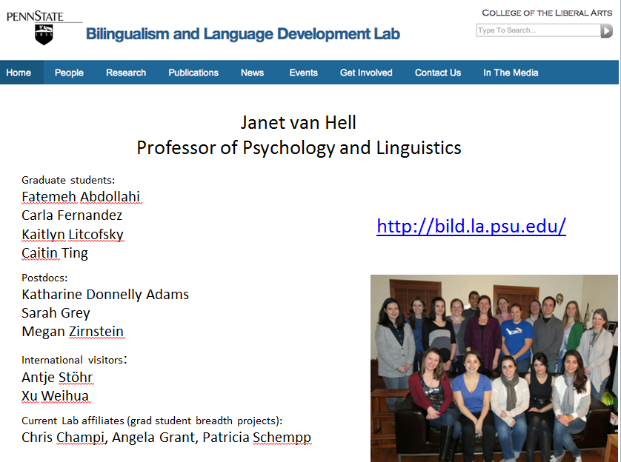

Slide 61
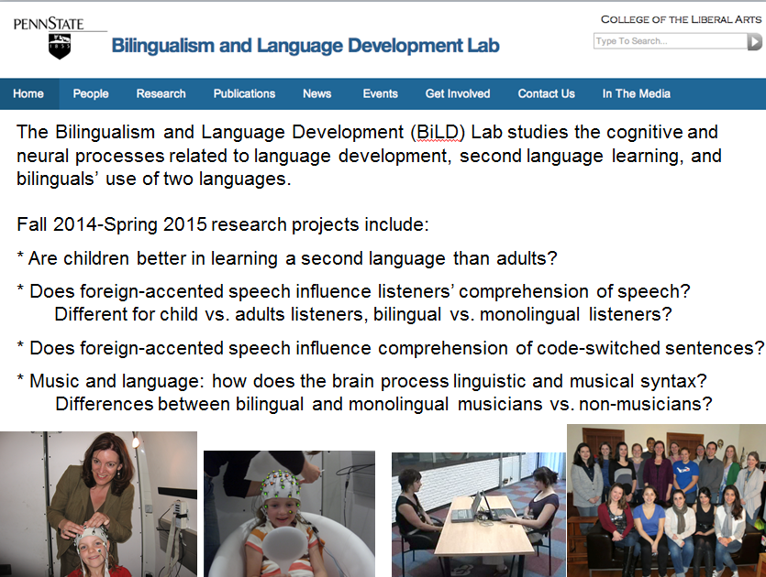

Slide 62
Dr. Patricia Román

Slide 63


Slide 64


Slide 65


Slide 66


Slide 67












Slide 68
Rhonda McClain

Slide 69


Slide 70
Nicole Benevento

Slide 71


Slide 72
Lauren Perroti

Slide 73


Slide 74
Pablo Requena

Slide 75


Slide 76
Haoyun Zhang

Slide 77





Haoyun Zhang

Slide 78
Paige Elinsky

Slide 79


Slide 80
Kyra Krass

Slide 81


Slide 82
Nick Anderegg

Slide 83


Slide 84
Thank You =)

